Slide 1

SQL Views
Maziar Shajari
Nov 2019 (Revised Nov 2020)

Slide 2
View Definition
In SQL, a view is a virtual table based on the result-set of an SQL statement.
A view contains rows and columns, just like a real table.
The fields in a view are fields from one or more real tables in the database.

Slide 3
View usage:
To focus, simplify, and customize the perception each user has of the database.
As a security mechanism by allowing users to access data through the view, without granting the users permissions to directly access the underlying base tables.
To provide a backward compatible interface to emulate a table whose schema has changed.

Slide 4
CREATE VIEW Syntax
CREATE VIEW view_name AS SELECT column1, column2, ... FROM table_name WHERE condition;
GO
Create View SimplePerson1
As
SELECT Top 20 BusinessEntityID,Title,FirstName,LastName
FROM Person.Person
WHERE title is not NULL;

Slide 5
View Example
GO
Create View SimplePerson
As
SELECT Top 20 BusinessEntityID,Title,FirstName,LastName
FROM Person.Person
Order by FirstName;
In view, ORDER BY can only be used with TOP x clause.
Better to name the view starting with vW to make it different from other queries.
Use this command:
SP_helptext SimplePerson;
To see the your view.

Slide 6
DROP the VIEW
Drop view ViewName
Drop view SimplePerson;
Drop view SimplePerson1;

Slide 7
Using a simple CREATE VIEW
-- *** Create a view using the AcventureWork2014 ***
USE AdventureWorks2014;
GO
CREATE VIEW hiredate_view
AS
SELECT p.FirstName, p.LastName, e.BusinessEntityID, e.HireDate
FROM HumanResources.Employee e
JOIN Person.Person AS p ON e.BusinessEntityID = p.BusinessEntityID;
GO
To see the result:
/****** Simple Query to Use the View ******/
SELECT FirstName
,LastName
,BusinessEntityID
,HireDate
FROM hiredate_view;

Slide 8
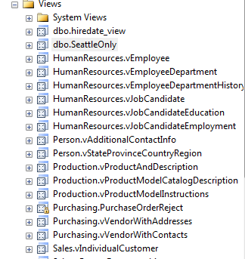
Using WITH ENCRYPTION
CREATE VIEW Purchasing.PurchaseOrderReject
WITH ENCRYPTION
AS
SELECT PurchaseOrderID, ReceivedQty, RejectedQty,
RejectedQty / ReceivedQty AS RejectRatio, DueDate
FROM Purchasing.PurchaseOrderDetail
WHERE RejectedQty / ReceivedQty > 0
AND DueDate > CONVERT(DATETIME,'20010630',101) ;
GO
Go to the View folder in the AdventureWork2014 database and see the difference.
The following example uses the WITH ENCRYPTION option and shows computed columns, renamed columns, and multiple columns.
Can NOT change the design

Slide 9
Using WITH CHECK OPTION
The following example shows a view named SeattleOnly that references five tables and allows for data modifications to apply only to employees who live in Seattle.
CREATE VIEW dbo.SeattleOnly
AS
SELECT p.LastName, p.FirstName, e.JobTitle, a.City, sp.StateProvinceCode
FROM HumanResources.Employee e
INNER JOIN Person.Person p
ON p.BusinessEntityID = e.BusinessEntityID
INNER JOIN Person.BusinessEntityAddress bea
ON bea.BusinessEntityID = e.BusinessEntityID
INNER JOIN Person.Address a
ON a.AddressID = bea.AddressID
INNER JOIN Person.StateProvince sp
ON sp.StateProvinceID = a.StateProvinceID
WHERE a.City = 'Seattle'
WITH CHECK OPTION;
GO
Watch the video in the next slide for the check option

Slide 10
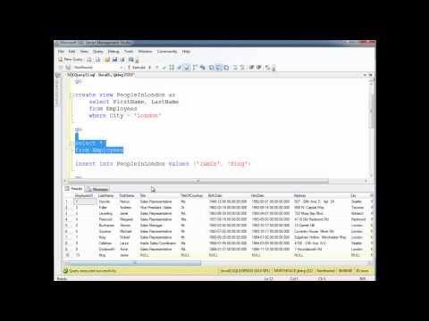
SQL Views, WITH CHECK OPTION

Slide 11
Using built-in functions within a view
CREATE VIEW Sales.SalesPersonPerform
AS
SELECT TOP (100) SalesPersonID, SUM(TotalDue) AS TotalSales
FROM Sales.SalesOrderHeader
WHERE OrderDate > CONVERT(DATETIME,'20001231',101)
GROUP BY SalesPersonID;
GO

Slide 12

Video
Duration: 7’59”
Watch the video and try the examples. You have 15 minutes.
https://www.youtube.com/watch?v=WQlksohMtsY&feature=emb_logo

Slide 13
A real view sample
SELECT e.BusinessEntityID, p.Title, p.FirstName, p.MiddleName, p.LastName, p.Suffix, e.JobTitle,
pp.PhoneNumber, pnt.Name AS PhoneNumberType, ea.EmailAddress, p.EmailPromotion, a.AddressLine1,
a.AddressLine2, a.City, sp.Name AS StateProvinceName, a.PostalCode, cr.Name AS CountryRegionName,
p.AdditionalContactInfo
FROM HumanResources.Employee AS e INNER JOIN Person.Person AS p
ON p.BusinessEntityID = e.BusinessEntityID INNER JOIN Person.BusinessEntityAddress AS bea
ON bea.BusinessEntityID = e.BusinessEntityID INNER JOIN Person.Address AS a
ON a.AddressID = bea.AddressID INNER JOIN Person.StateProvince AS sp
ON sp.StateProvinceID = a.StateProvinceID INNER JOIN Person.CountryRegion AS cr
ON cr.CountryRegionCode = sp.CountryRegionCode LEFT OUTER JOIN Person.PersonPhone AS pp
ON pp.BusinessEntityID = p.BusinessEntityID LEFT OUTER JOIN Person.PhoneNumberType AS pnt
ON pp.PhoneNumberTypeID = pnt.PhoneNumberTypeID LEFT OUTER JOIN
Person.EmailAddress AS ea ON p.BusinessEntityID = ea.BusinessEntityID
Let’s convert it to an view. The view name is ‘Daily Report’ and it has to be added to AdventureWork database.
Select * from [Daily sample]

Slide 14
Questions?

Slide 15
Extra assignment
How we can use ‘ORDER BY’ in a view? Do a research and find simple examples. You might need it for the exam.

Slide 16

Watch the Video

